Slide 1

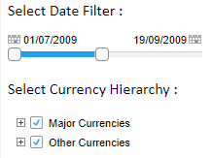
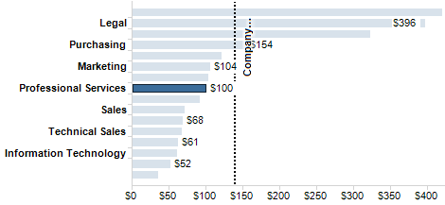
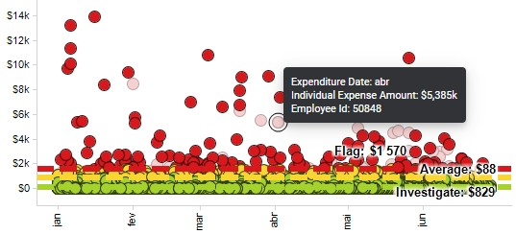
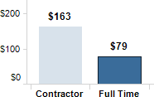
Presentation and Interaction
Universidade de Aveiro Departamento de Electrónica, Telecomunicações e Informática
https://www.tibco.com/products/tibco-spotfire/learn/demos
InfoVis, Universidade de Aveiro, 2022
Beatriz Sousa Santos

Slide 2
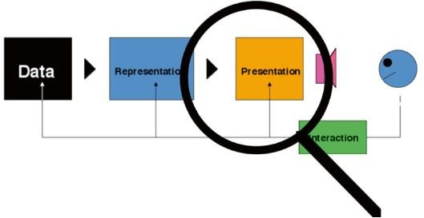
The presentation issue
The issue of layout is important due to the limited screen real estate
Irrespective of how data may be represented decisions have to be made:
– how the representation is to be displayed
– whether it is to be displayed
Links to representation and
interaction are important
(Spence, 2014)
2

Slide 3
To help overcome space limitations
Scrolling
Overview + detail
Distortion
Suppression
Zoom and pan
3

Slide 4
 | 7.1 A P ROBLEM
 | Man y of us have fou nd ou rselves wit h a repo rt t hat has to be co mp leted by a deadl ine, wit h th er esu lt ( Fig ure 7.1) that th ed ini ng ro om tabl e, extend ed to it s 12- gu es t s t at e,i s co vered by pil es of p ap er a well as r ep ort s, b ooks , cli ppi ngs and s li des; perhap s w ith mor e ar ranged o n th efl oor an d on a coup le of chairs . Th er emay even b ep iles on t op of p iles . Su ch ap resen tati on of vi tal i nformati on makes a lo t of sens e: every thi ng rel ev an t is to hand ( hopeful ly! ) and, mor eo ver, it s v ery vi s ibi lit y acts as a remind er (Bol 19 84, page 2) of what mig ht be r el evant at any p ar ti cu lar j unctu re, pos s ibl y tr igg er ing asi tuated acti on ( Suchman, 19 87). I n thi s en vir onment I can concent rate on cr eat ive tas ks rat her th an or ganis ati on. | s t,
 | Des pit e the avail ab ili ty o fh igh -res ol uti on di sp lays and po werful work s tatio ns I s ti ll wr ite mos t o fmy r eport s in th is way. Why ? Becaus e th ed is play ar ea pr ovi ded by t he typ ical wo rks tat ion i s far t oo smal to su ppor t, vi si bl y, al l th eso urces that a rel ev an t to my co mp os iti on. | l e
 | 7.2 THE PRESENTATION PRO BLEM
 | I am not al one in the sens eo f havin g too much data t o fit o nto a small screen. A very large and expen si ve scr een ,fo r exampl e,w oul d be needed to dis pl ay the L ond on Und ergr ound map i n s ufficien t detail (F igur e 1.1), and i t wo uld be di ffi cult or imp os si ble t o pres ent, o n a no rmal dis pl ay, the compl et e or ganis ati on char t of IBM or ICI . M oreov er , the recent emergen ce of small and mob ile in formati on and communicati on d ev ices su ch as P DAs and wearab le dis pl ays has ad dit ional ly id en tifi ed ap ressing n eed fo r a s olut ion to the ‘ too much data, too l it tle di sp lay area’ prob lem: thperes entat ion
7.2.1 Scro lli ng An o bvi ous s olu tio n is to scro ll t he data in to and o ut o ft he vis i ble area. In ot her wor ds , to p rovi de a means wher eb y a lo ng do cu men t can be mo ved pas t a wi ndow u nti l it reaches t he requi red ‘ page’ (Fi gur e7 .2). Th is mechani smi s wi dely us ed, bu t carri es w ith i t many penal ties . One relat es t o the "W here am I? " pr oblem: I ’m wo rki ng on Ch ap ter 2,
 | – or was i t 5.6 ? All I can do is op erate the scrol lin g mechan isman d loo k out for th efi gur eI need , al beit as s is t ed by vari ous cues s uch as t he page number in dicated i n the scro lli ng mech anis m. Wit h a scr oll ing mechani s m, mos t of a do cu ment ishi dden from vi ew. I have th esamep rob lem when us in g a micro fi lm reader, wi th t he ad dit ion al compli cat ion that i f I move th et ray to the left, t he image mo ves t o th er igh t. A s imil ar diffi cu lty ap pli es t o my us e of the famo us Lo ndo n ‘ AtoZ ’ s t reet di rector y. I’ m dri vin g alon g a road t hat go es off th eedg eo f the page, so I d es per at ely need wh at ever page cont ains th e cont inu at ion of that road ( an d qui ckly! ). E ven if I g et it ,I wil l ty picall y have tr oub le locati ng t he same road o n the new pag e. Th ese and o ther s i mi lar pr obl ems can be ameli orat ed by th e pr ovi si on of cont ext . Mu ch of thi s chapt er , in fact, is concern ed wit h decid ing h ow to pr o vi de conte. xt
Scrolling consists in moving displayed text or graphics on a screen in order to view different parts of them
an obvious solution when a document is larger than
the display area
A long document can be moved past a “window”
Often it is not a satisfactory solution
Scrolling hides most of a document:
there is not a view of context as well as detail
5

Slide 5
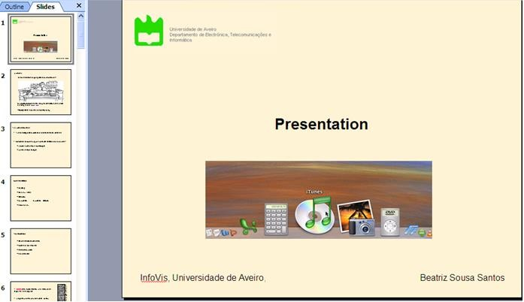
Two separate views of detail and of context can be combined in a
overview + detail view helps with the focus + context problem
“You are here”
6

Slide 6
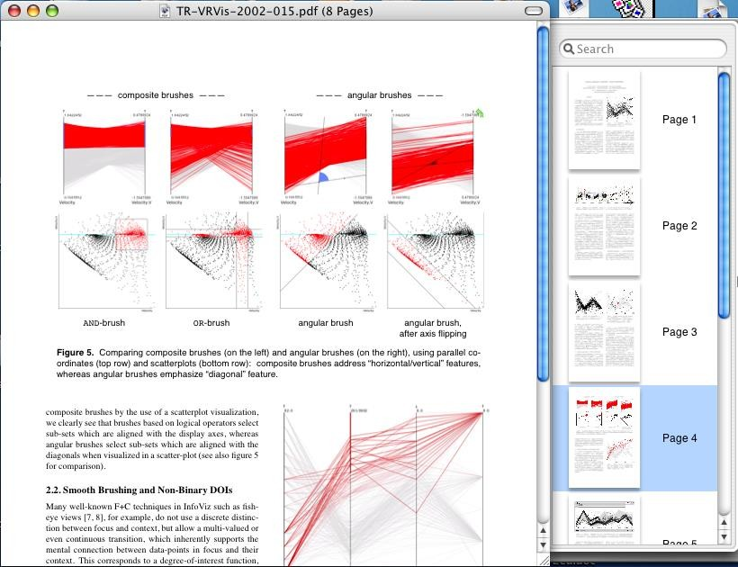
Another example
Detail plus Overview. Miniatures of pages of a pdf document provide useful context while attention is paid to detail of one page (Spence, 2007)
7

Slide 7


Distortion offers a way of solving the focus + context problem
An information space containing documents, emails, etc.
The bifocal display (Spence and Apperley, 1982) uses distortion and is based on a simple metaphor
direction of view
Part of an information space can be viewed in detail; a bird’s eye view is provided of the remainder
Original videos:
http://www.youtube.com/watch?v=DaF5brrdpJw
(b) The same space wrapped around two uprights.
http://www.youtube.com/watch?v=gNTQaH8MM98&NR=1
(c) Appearance of the information space when viewed from an appropriate direction
8

Slide 8
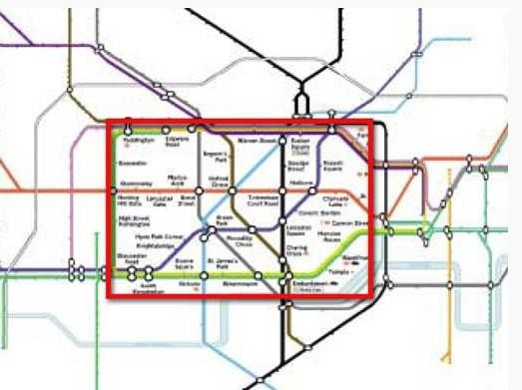
The Bifocal Display is an information presentation technique which allows a large data space to be viewed as a whole, while simultaneously a portion is seen in detail. The detail is seen in the context of the overview, with continuity across the boundaries, rather than existing in a disjoint window
https://www.interaction-design.org/literature/book/the-encyclopedia-of- human-computer-interaction-2nd-ed/bifocal-display
9

Slide 9
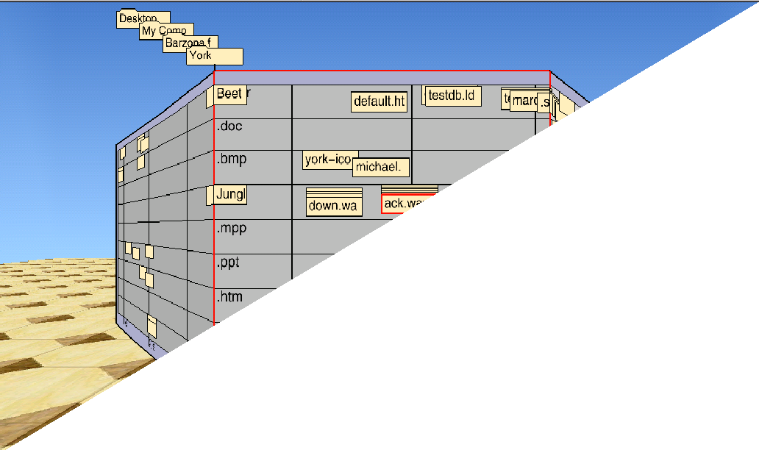
The Perspective Wall applies a 3D effect to the Bifocal Display
(Mackinlay et al.,1991)
http://www.youtube.com/watch?v=hYUZbrWtCZg
10

Slide 10
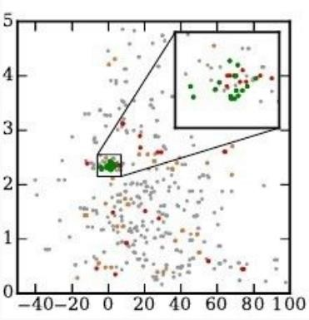
Another example
The use of a “magnifying glass” helps
minimize the focus + context problem
a small region of interest is shown amplified and the context is maintained
(Tao et al., 2021)
11

Slide 11
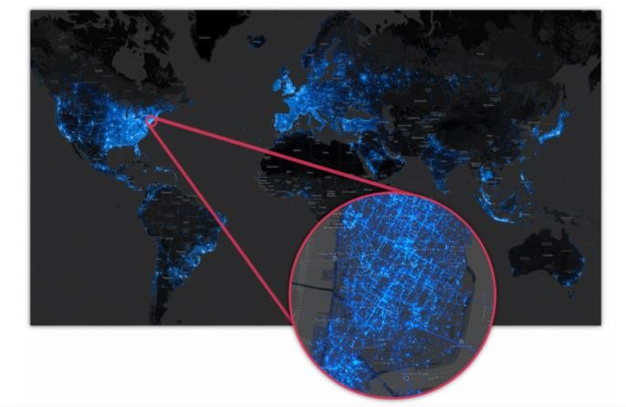
Example: a small region of interest a context map can be
flexibly positioned to provide a magnified view
https://databricks.com/blog/2015/03/19/pantera-big-data- visualization-leverages-the-power-of-the-databricks-cloud.html

Slide 12
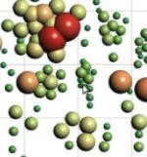
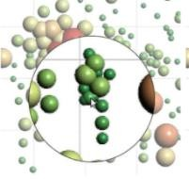
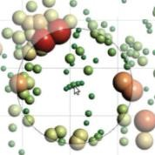
The magic lens offers another way of solving the focus + context problem
•
t
Original view
Simple
magnification
Fish-eye distortion
(Tominski et al., 2016)

Slide 13
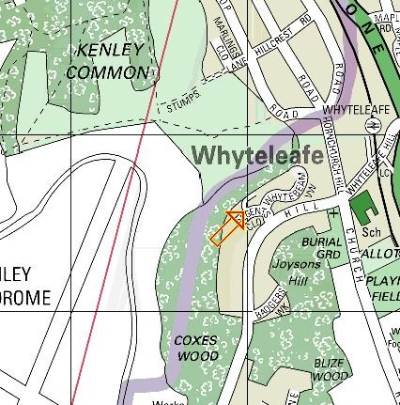
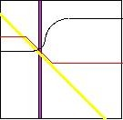
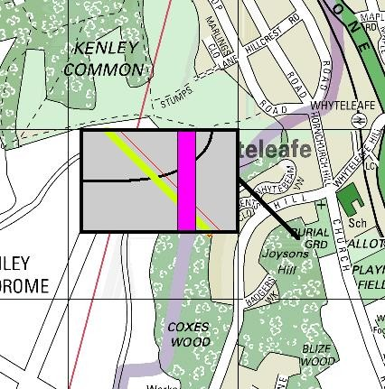
Suppression finds valuable application in the Magic Lens (Stone et al., 1994)
Magic Lens:
shows a conventional map of an area,
shows the location of services (gas, water and electricity pipes)
a (movable) Magic Lens shows services in an area of interest, in context
(Spence, 2007)

Slide 14
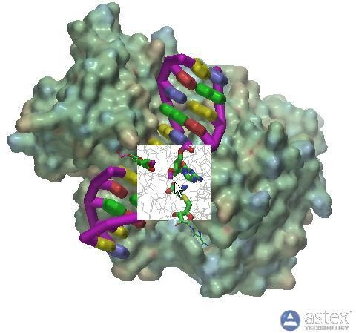
A molecular surface of the protein transferase colored by electrostatic potential bound to DNA shown as a schematic. The magic lens window allows a view of the atomic structure bonding to be shown, with the bound ligand structure highlighted as cylinders, thereby providing a view inside the protein (Spence, 2007)

Slide 15
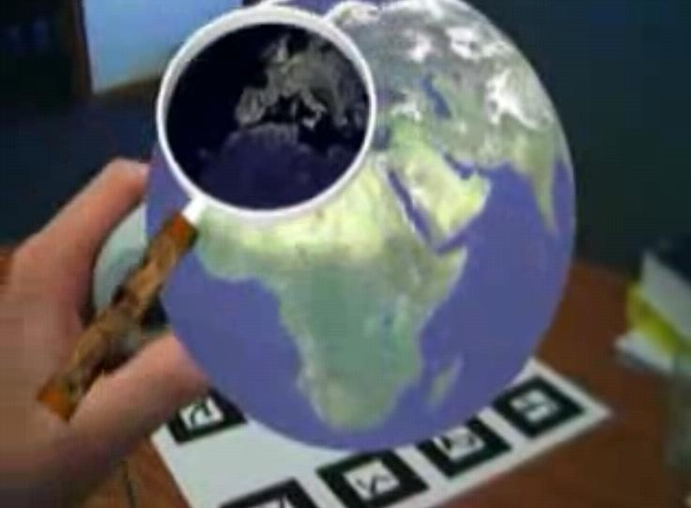
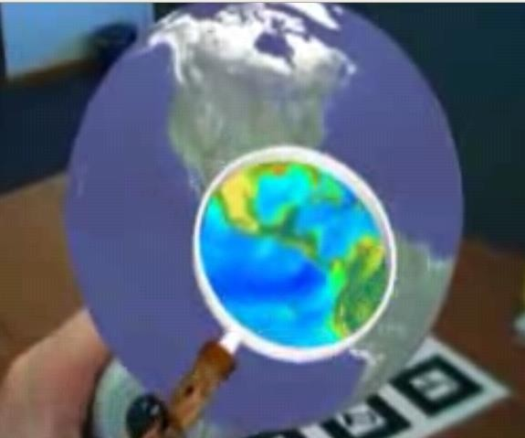
The Magic Lens using Augmented Reality for
Data Visualization
http://www.youtube.com/watch?v=3zIq_qb8CSE&NR=1
17

Slide 16
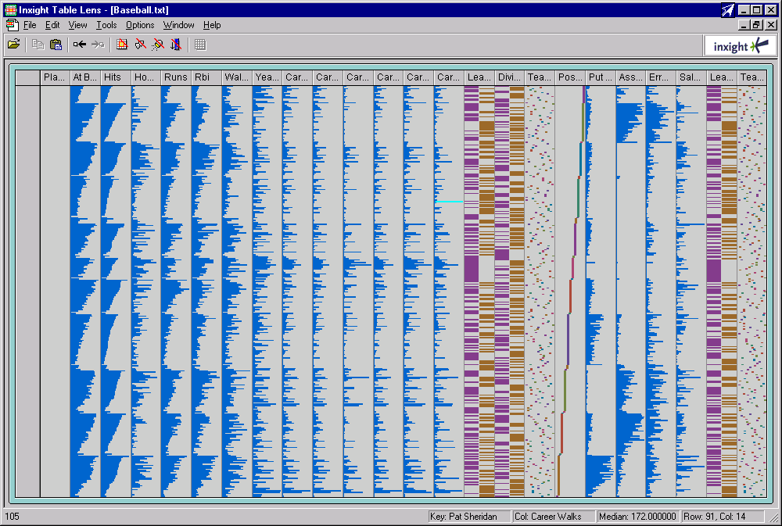
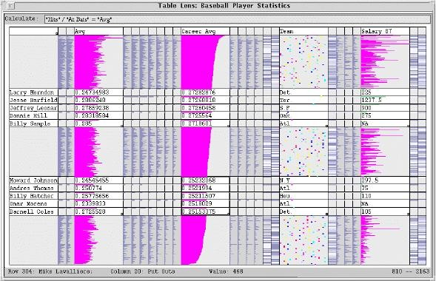
The Table Lens is method to dynamically explore large amounts of tabular data
The Table Lens
(Rao and Card, 1995)
without distortion;
with distortion (expansion) to show names
18
http://www.youtube.com/watch?v=qWqTrRAC52U

Slide 17
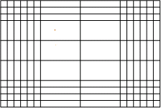
This simple but powerful concept can be generalized
X-distortion
It is possible to use X and Y distortion
Mar | A pril | May | June | July |  |  |  |  | A ug | Sept | Oct
 |  |  |  |  | 11Sun Check slides , notes . Family barbeque
 |  |  |  |  | 12 Mon | Fly LA Kathy to airport Model Maker
 |  |  |  |  | 13 Tue
 |  |  |  |  | 14 Wed
 |  |  |  |  | 15 Thur
 |  |  |  |  | 16 Fri | Flight to SFO Tut orial set-up Tut orial United f light Heathrow Pointer Color OHs Jane+J ohn Call Kathy
 |  |  |  |  | 17Sat Fly LHR Kathy to collec t Chapt er 2/ see Dave March
X and Y -distortion
Calendar interface using X and Y distortion (Bederson et al., 2003, 2004)
19

Slide 18
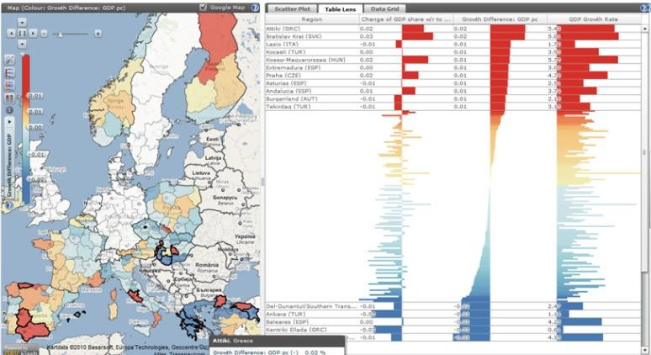
The Table Lens a is method to dynamically explore large amounts of tabular data
https://ncva.itn.liu.se/education-geovisual-analytics/table-lens?l=en
It allows to sort records, focus “zoom” in on interesting areas in the data (to reveal exact numerical information) using “focus + context''
20

Slide 19
Furnas proposed a Degree of Interest (DoI) to determine which data should be represented and presented and which should be suppressed
The Degree of Interest of any item is expressed as a function of:
A priori importance (API)
Distance (D) between that item and the item which is currently the
user’s focus of interest
22

Slide 20













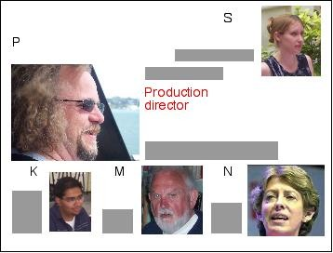








Example (Spence, 2007)
Considering only Distance:
3- The context defined by setting an upper threshold
of unity for distance from a focus
1-The organization tree of a company
Context
President
S
P
S
Focus
P
K M
K M
N
F G
2- Distance ’D’ of each node from the focus of attention
2
4- Display that might be associated
with the focus and context defined
1
3
3
P
Focus
2 2
4
4
1
1
1
2
2
23

Slide 21




















Example (Spence, 2007)
Considering a priori importance:
A priori importance:
10
9
9
9
Distance to the focus:
2
8
8
8
8
8
1
3
7
3
7 7
P
Focus
2 2
4
4
6
6
1
1
1
2
2
What is shown/suppressed:
Context
8
8
Nodal values of Degree of Interest:
6
6
DoI =API – D
8
6 6
Focus
4
4
Setting a lower limit of 6 for DoI identifies
the nodes within the shaded region
6
6 6
4
4
24

Slide 22
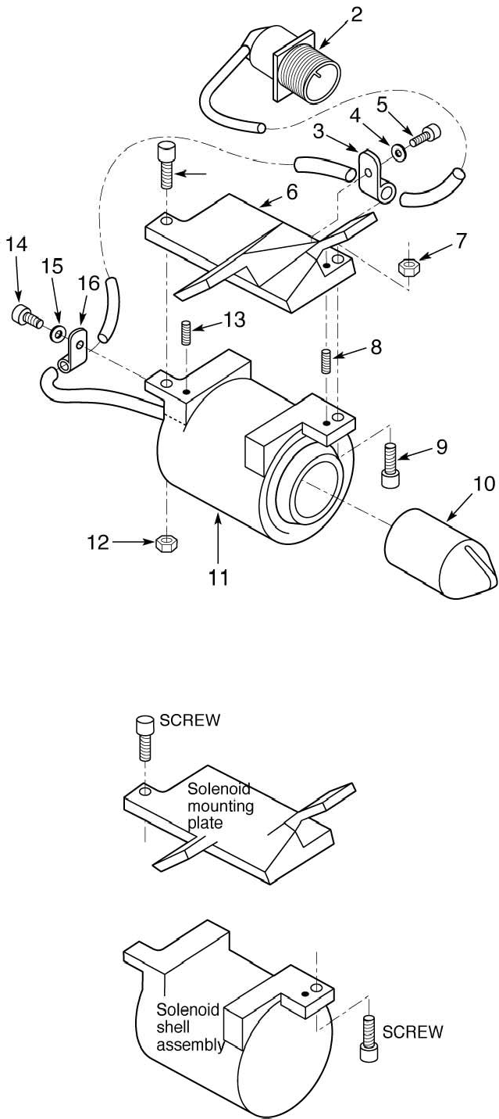
Example:
Part of an engineering drawing
The engineering drawing simplified
in the context of a suspected fault
(Spence, 2007)

Slide 23
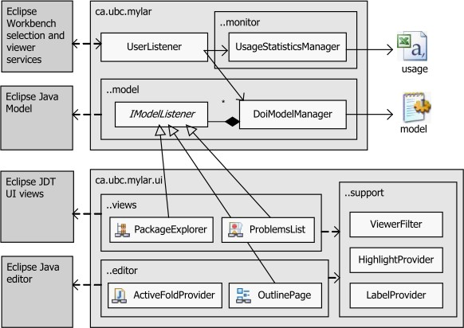
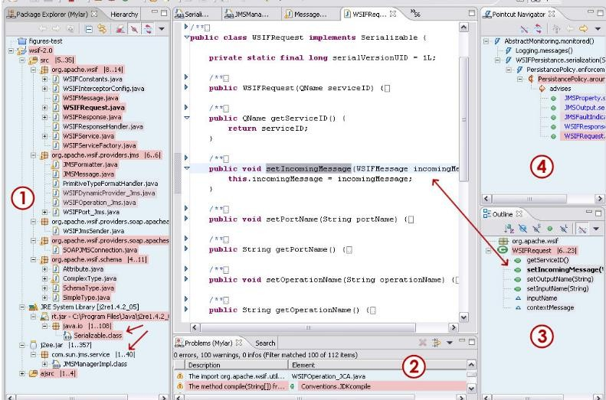
Another example :
Encoding the DOI of program elements
by monitoring the programmer's activity
Package explorer: Only the files and
libraries relevant for the task are visible
Problems list: highlights problems of interest
(Kersten & Murphy, 2005)
Outline: interest-based filtering shows only what is related to the task
Active Pointcut Navigator: actively updated

Slide 24
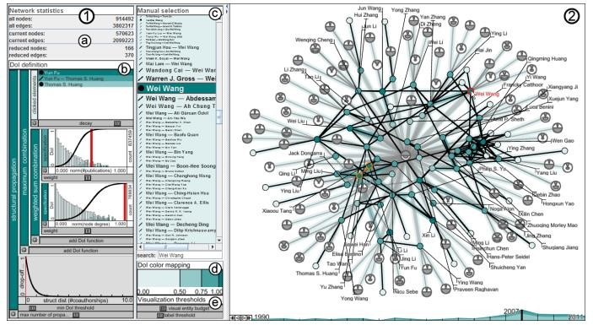
Another example :
providing both overview and detail on a dynamic citation network is a challenge, and small changes can be drowned out by larger ones
a degree-of-interest specification by which the user can identify salient changes at the desired scale and importance may help
Two main views: (1) the DoI view and (2) the Network view (a snapshot of the DBLP dataset for the year 2007 reduced according to the defined DoI function).
27
(Abello et al., 2014)

Slide 25
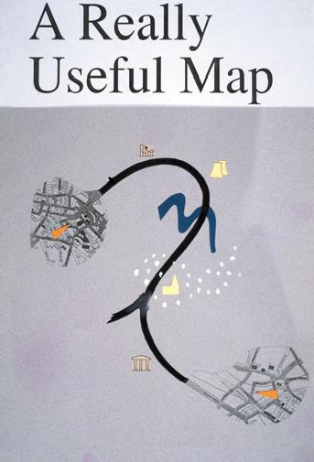
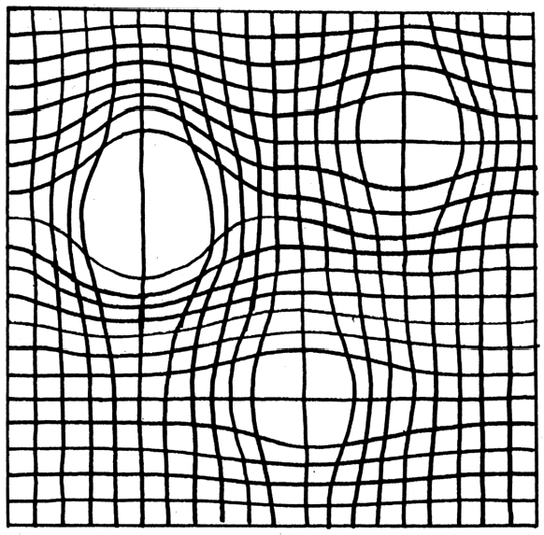
A combination of distortion and
suppression can be beneficial
(Spence, 2007)
It is a map appropriate to a journey from one city to another
This example uses the concept of rubber sheet distortion
detail
distortion

Slide 26
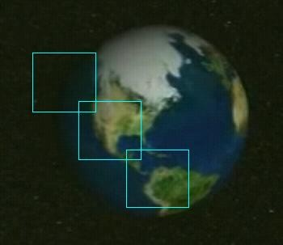

1
2
3
Panning is the smooth movement of a viewing frame over a 2D image

Slide 27
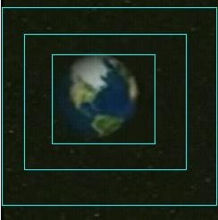



3
2
1
1
2
3
Zooming is the increasing magnification of a fraction of an image (or vice versa)

Slide 28
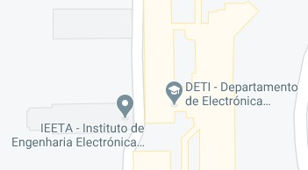

In semantic zoom the meaning conveyed by the new view differs from the conveyed by the previous one
60
50
40 35 30 |  | Ford Nis san VW Merc Jag Jag Ford SEAT
Price ( £K)
(Spence, 2007)
40
30
20
10
32

Slide 29
Visual Information-Seeking Mantra
(Shneiderman, 1996)
“Overview first, zoom and filter, then details-on-demand”
Few, S., The Surest Path to Visual Discovery https://www.perceptualedge.com/articles/b- eye/path_to_visual_discovery.pdf
Not always… (some domain experts operate
under a Details-first model (not Overview-first)

Slide 30
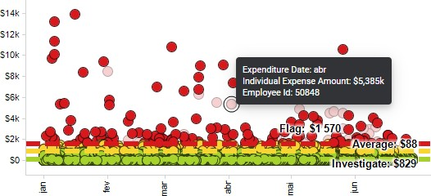
Annotation
Is about creating extra layers of data detail through interactive events such as hovering or clicking
This is particularly useful to reveal actual data values or extra detail about a given category or event
By having the backup of absolute data accuracy through the values, allows
using a more creative visual representation
It's almost like having a “perceptual safety net” (Kirk, 2019)

Slide 31
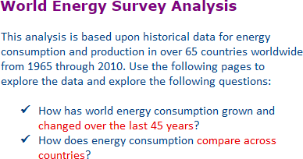

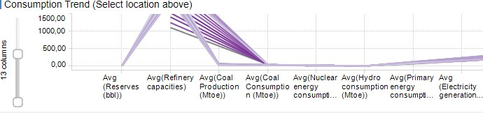
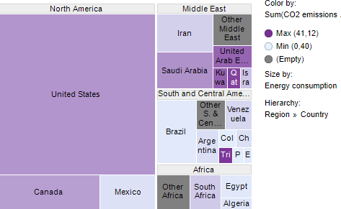
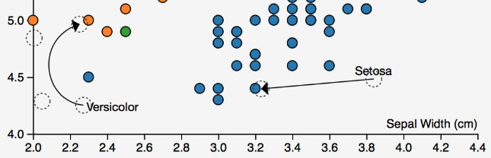
Annotation
Can help explain and facilitate the viewing and interpretive experience:
Titles and introductions
Captions, labels and units
User guides
Attribution
Data sources
https://medium.com/@Elijah_Meeks/ making-annotations-first-class-citizens- in-data-visualization-21db6383d3fe

Slide 32
Creating Interaction
Enhancements in technology over the past decade have created incredible opportunities to construct powerful interactive visualizations
The development of an interactive design requires technical capabilities Technical constraints should be pondered:
as platform compatibility,
data loading speed,
server capacity
…
If not correctly tackled the usefulness and UX is compromised

Slide 33
Creating Interaction
When the complexity of the data is incompatible with a static portrayal, interaction is vital
Careful consideration of the motivation and intention is still needed;
specifically: what functional experience is the goal of the design?
exploratory,
explanatory,
or maybe a combined design?
Different features and functions should be considered:
Manipulating variables and parameters (e.g. select, filter, modify, sort, …)
Adjusting the view
Annotating details
Animation

Slide 34
Manipulating variables and parameters
The ability to select, filter, exclude, or modify certain variables is a
valuable way of letting the user interact with different slices of the data
Grouping and sorting options are common for extracting new insights
You can also modify a variable using a slider to see changes across
numerous values of the variable
Brushing —highlighting a set of data marks—is a powerful way of focusing
in on a subset view the presented data

Slide 35
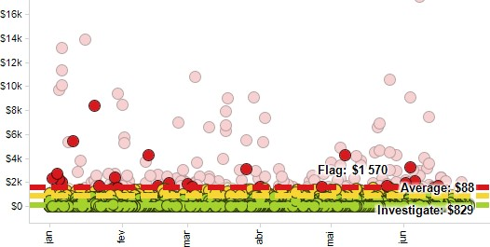
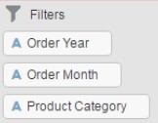
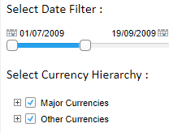
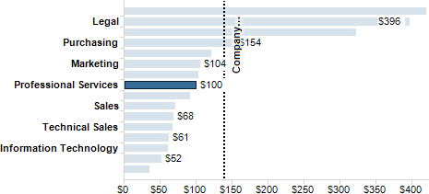
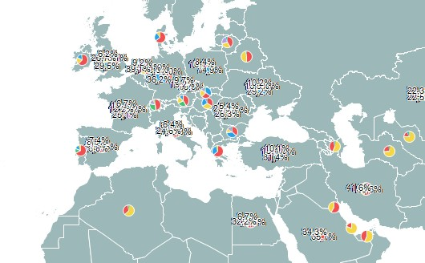
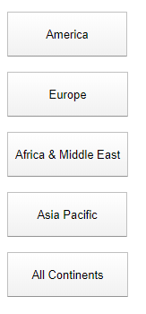
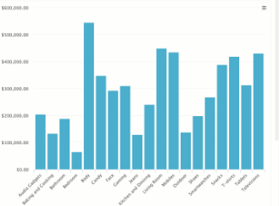
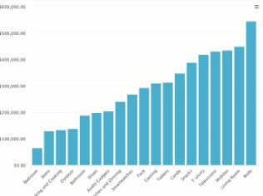

Manipulating variables and parameters (e.g. select, filter, modify, sort, …)
select
brushing
sort

Slide 36
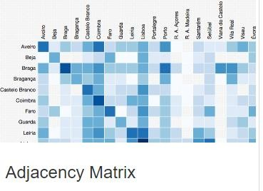
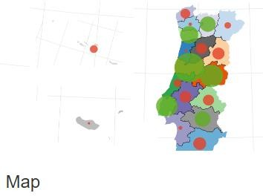
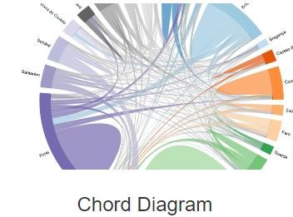

Example: Portuguese Higher Education access data
Candidates and institutions data were provided by Direcção Geral do Ensino Superior (2012, 2013 and 2014) of Portuguese students applications to Higher Education (115636 students applications from 20 districts to 305 institutions).
by Tiago Brito (MSc thesis, UA)
https://migration- flow.herokuapp.com/

Slide 37
Main bibliography
Spence, R., Information Visualization, An Introduction, 3rd ed., Springer, 2014
Spence, R., Information Visualization, Design for Interaction, 2nd ed., Prentice Hall, 2007
Kirk, A., Data Visualisation: A Handbook for Data Driven Design, SAGE Publications, 2019
Kirk, A., Data Visualization: a successful design process, Packt Publishing, 2012
Munzner, T., Visualization Analysis and Design, A K Peters/CRC Press, 2014
Ware, C., Information Visualization: Perception for Design, 3rd ed Morgan Kaufmann 2012
Acknowledgement: The author of these slides is grateful to Professor Robert Spence as he provided the electronic version of his book figures, as well as to colleagues and students who have provided examples

Slide 38
Other bibliography
Abello, J., S. Hadlak, H. Schumann and H. Schulz, "A Modular Degree-of-Interest Specification for the Visual Analysis of Large Dynamic Networks," IEEE Transactions on Visualization and Computer Graphics, vol. 20, no. 3, pp. 337-350, March 2014 https://ieeexplore.ieee.org/document/6574858/citations?tabFilter=papers#citations
Cockburn, A., Karlson, A., and Bederson, B., “A Review of Overview + Detail , Zooming , and Focus +
Context Interfaces,” ACM Comput. Surv., January, 2009.
https://dl.acm.org/doi/10.1145/1456650.1456652
Kersten, M. and Murphy G., “Mylar : a degree-of-interest model for IDEs,” Proceedings of the 4th international conference on Aspect-oriented software development AOSD'05, pp. 159–168.
https://dl.acm.org/doi/10.1145/1052898.1052912
W. Tao, et al, "Kyrix-S: Authoring Scalable Scatterplot Visualizations of Big Data," IEEE Transactions
on Visualization and Computer Graphics, vol. 27, no. 2, pp. 401-411
Tominski, C., Gladisch, S., Kister, U., Dachselt, R. and Schumann, H., “Interactive Lenses for Visualization : An Extended Survey,” Comput. Graph. Forum, vol. 36, no. 6, pp. 173–200, 2017. https://onlinelibrary.wiley.com/doi/abs/10.1111/cgf.12871
Visualization Wiki, http://www.wikiviz.org/wiki/Main_Page Examples: https://www.tibco.com/products/tibco-spotfire/learn/demos

